Slide 1
Carolina Vegetation
Survey
Restoration Target Tool
Michael T. Lee
October 17, 2012
Title

Slide 2
The Carolina Vegetation Survey
Multi-institutional collaborative program.
Established in 1988 to document the composition and status of natural vegetation of the Carolinas.
Provides data, data services, soft- ware development to support CVS protocol.

Slide 3
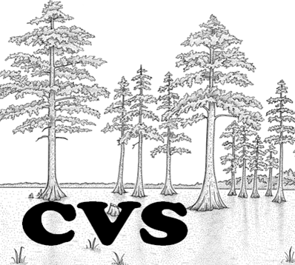
CVS Team
Project Leaders
Robert Peet, UNC-CH
Thomas Wentworth, NCSU
Alan Weakley, NC Botanical Garden
Michael Schafale, NC Natural Heritage Program
Staff
Michael Lee, Software Developer

Slide 4
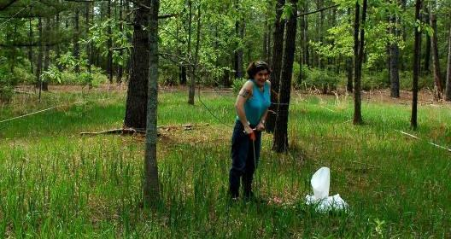
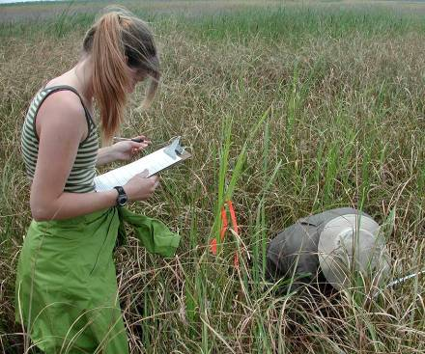
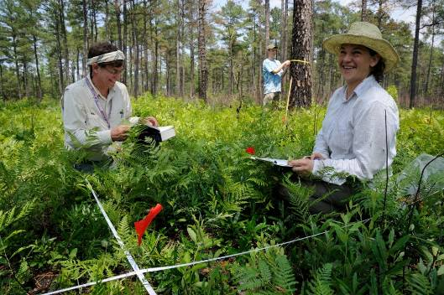
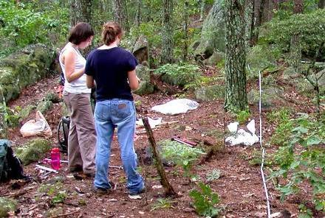
Carolina Vegetation Survey Plot Sampling

Slide 5
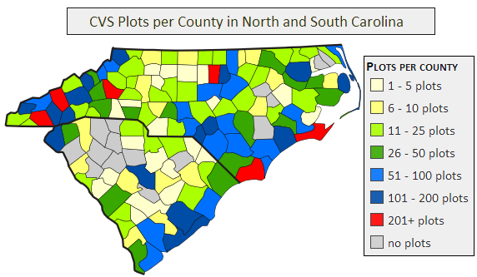
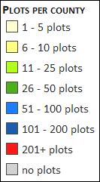
Database of CVS Plots
> 6500 plots provide high-quality reference sites
280 Natural community types with >= 4 plots
495 Natural community types with >= 1 plot
Available data include
- Species frequency
- Species importance
- Woody stem diameters
- Site data
- Soil data
- Maps of occurrences
- Descriptions

Slide 6
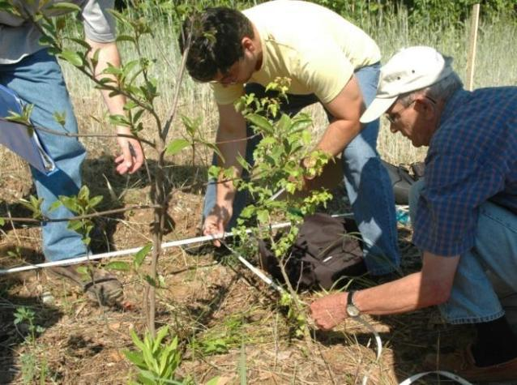
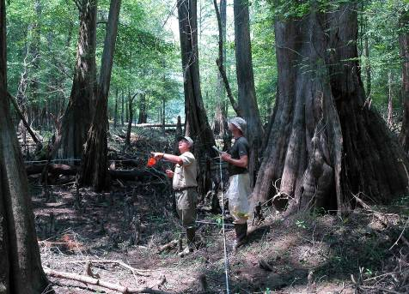
The CVS-EEP Partnership
Working together to restore North Carolina’s natural communities
restoration sites
target reference sites

Slide 7
A Restoration Target Tool
Your restoration site pre-construction environmental variables
CVS database of 6,500+ high quality vegetation plots in Carolinas
Which target communities are most similar to my site?
What plants are found in those communities?

Slide 8
Restoration Target Tool Goal
For any stream or wetland site in North Carolina,
you provide environmental data,
our tool calculates which community type(s) best match your site,
and provides you with a planting list.

Slide 9
Step 1: Define Scope of Targets
All wetland and streams community types in North Carolina
Several areas have targeted studies:
Mountain Rivers
Mountain Bogs
Piedmont Rivers
Piedmont Seeps and Depression Swamps
Coastal Plain Brownwater Rivers
Coastal Fringe Wetlands

Slide 10
Step 2: Identify Targets
Follow National Vegetation Classification associations (CEGLs)
Use custom classifications for targeted studies
293 targets identified
1,342 plots define environment, vegetation targets

Slide 11
Plots in the CVS Target Tool, by Region

Slide 12
Step 3: Easily Obtained Predictive Environmental Variables
Elevation
Slope
Aspect
McNab Landform Index
McNab Terrain Shape Index
Distance To Channel
Floodplain Width
Watershed Area
River Basin
Stream Order
Hydrologic Regime
Geology
Geomorphology
Topographic Position
Latitude
Longitude
Soil Great Group
Soil Series
Map Unit
Everything is optional, but more data provide better matching capability

Slide 13
Step 4: Summarize Targets
Numeric variables (elevation, watershed area, etc.)
Relativized to a 0-1 scale
Then averaged for all plots in target community
Categorical variables (geomorphology, soil series, etc.)
Constancy (# times a value occurs in group / # plots in group)
Fidelity (# times a value occurs in group / # times value occurs in dataset)
Types summarized more fully on CVS website

Slide 14
CVS Community Type Summary
http://cvs.bio.unc.edu

Slide 15
Constancy and Fidelity
Constancy = a / x
If I find group x, how likely is it to also see this categorical value?
x plots in group
y plots with cat. val.
X
a
y
Fidelity = a / y
If I find this categorical value on a plot, how likely is it be part of group x?

Slide 16
Constancy and Fidelity
High constancy, low fidelity
High fidelity, low constancy
High fidelity, high constancy

Slide 17
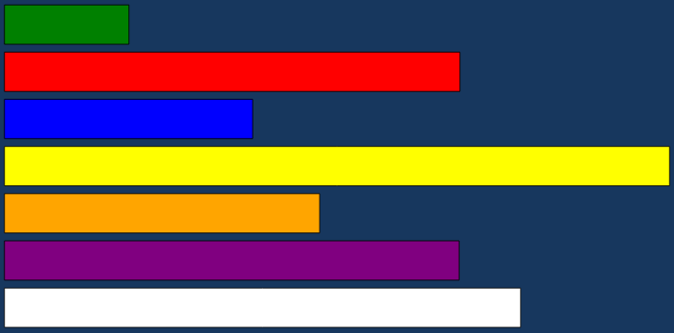
Step 4: Example Target Summary
Numerical Variable | Rel Avg
slope | 0.158
TSI | 0.578
LFI | 0.315
longitude | 0.844
latitude | 0.400
elevation | 0.577
aspect | 0.655
Categorical Variable | Value | Constancy | Fidelity
Topo Position | Toeslope | 0.063 | 0.250
Topo Position | Lowslope | 0.125 | 0.500
Topo Position | Low level | 0.750 | 0.750
Topo Position | High slope | 0.063 | 1.000
Soil Series | TUSQUITEE | 0.125 | 1.000
Soil Series | SUNCOOK | 0.125 | 1.000
Soil Series | COLVARD | 0.125 | 0.500
Soil Series | CHANDLER | 0.375 | 0.600
Soil Series | ASHE | 0.250 | 1.000
Soil Great Group | TYPIC UDIPSAMMENTS | 0.125 | 1.000
Soil Great Group | TYPIC UDIFLUVENTS | 0.125 | 0.500
Soil Great Group | TYPIC DYSTRUDEPTS | 0.750 | 0.750
Hydrologic Regime | Seasonally flooded | 0.071 | 1.000
Hydrologic Regime | Intermittently flooded | 0.929 | 0.650

Slide 18
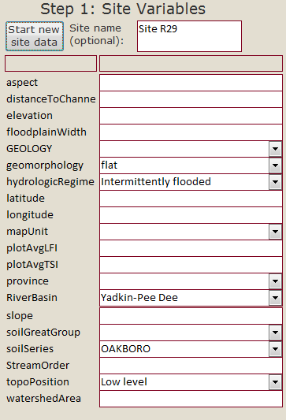
Step 5: Input Site Data
Select region (e.g., Piedmont Rivers)
Enter variables, some of which can be derived from GIS, others require a site visit

Slide 19
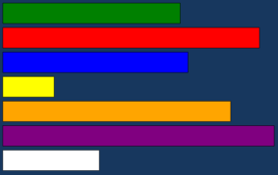
Step 6: Tool Calculates Similarity to Each Target
Your site variables are translated just as target sites were:
Similarity between each variable on your site and that of each target is calculated, using the difference between numerical values and constancy/fidelity values
Averaging these values gives a similarity value for your site to a target community

Slide 20
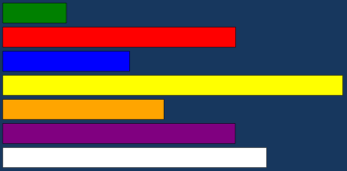
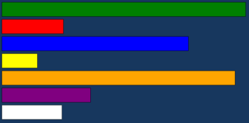
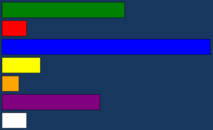
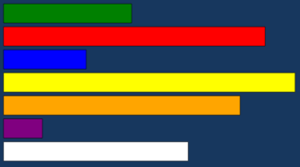
Calculating similarity between your site:
And targets:
0.50
0.41
0.75

Slide 21
Step 6: Tool Calculates Similarity to Each Target
Similar “good” targets to your site
Dissimilar “bad” targets
You select target(s) that are best, and the tool generates a planting list.

Slide 22
Step 7: Tool Selects Plots, Then Species
Plots from one or more targets
Refine list of plots even further, based on environment variables (e.g., soil series, location).
The tool assembles a planting list with the most common species for each target.

Slide 23
Example Planting List for Targets

Slide 24
Caveats & issues (my opinion)
This tool is still a prototype. Further testing and validation is in progress.
CVS coverage of the state is very good, the best we know of, however some places will not match a target site well.
This tool is meant to assist planting plans, not entirely replace current methods. Your experience and ability to think about an individual site and its quirks matters.

Slide 25
Future Steps
Validation of the tool: use environmental data from existing EEP plots to select targets and generate a planting list. Compare success of species on list with those actually planted.
Evaluate proposed planting lists by comparing to species selected by the tool.

Slide 26
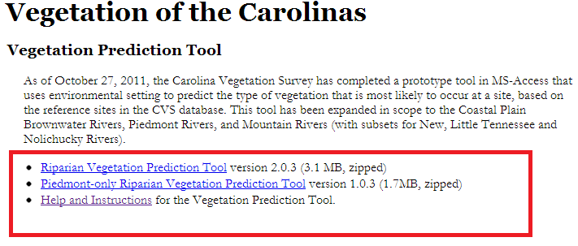
Download Now
http://cvs.bio.unc.edu
Vegetation of the Carolinas link

