Slide 1





Advantages of Monitoring Vegetation Restoration With the Carolina Vegetation Survey Protocol
M. Forbes Boyle, Robert K. Peet, Thomas R. Wentworth, and Michael Lee
17 November 2010

Slide 2


The CVS Team
Project Directors
  Robert Peet, UNC Chapel Hill
  Thomas Wentworth, NC State University
  Michael Schafale, NC Natural Heritage Program
  Alan Weakley, NC Botanical Garden
Staff
  Forbes Boyle, Project Manager
  Michael Lee, Database admin & software developer

Slide 3
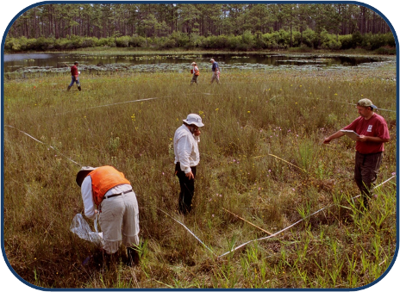
The Carolina Vegetation Survey (CVS)
Multi-institutional collaborative program.
Established in 1988 to document the composition and status of natural vegetation of the Carolinas
Over 5000 plots, containing over 2000 species, representing over 200 vegetation types (2004)

Slide 4
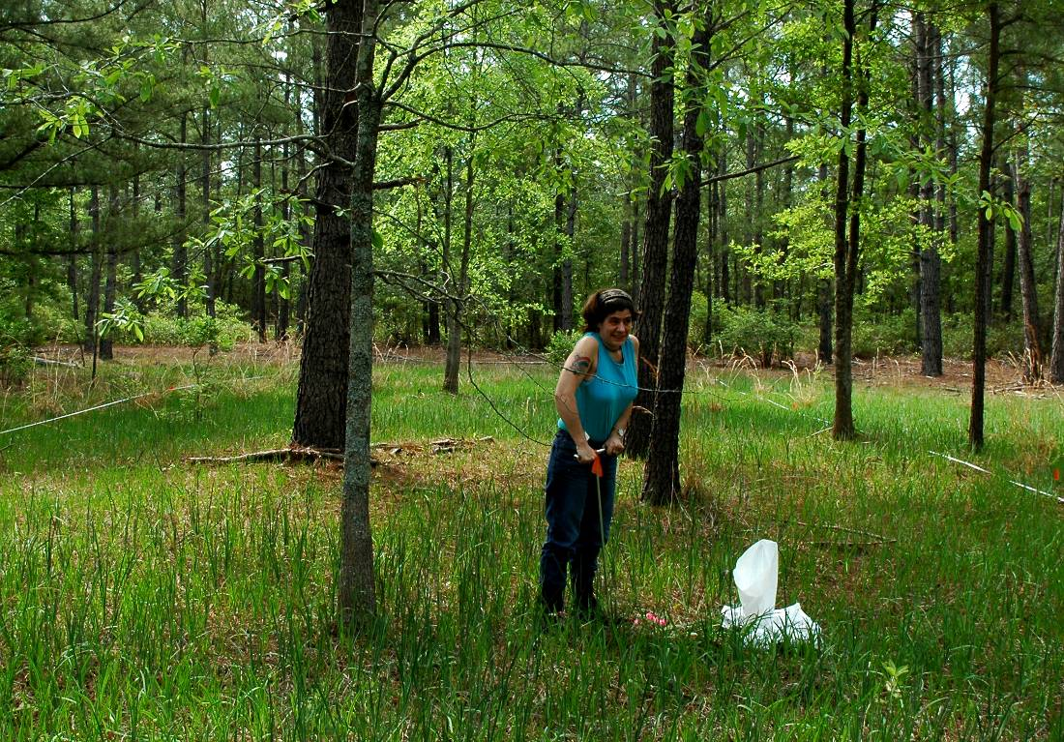
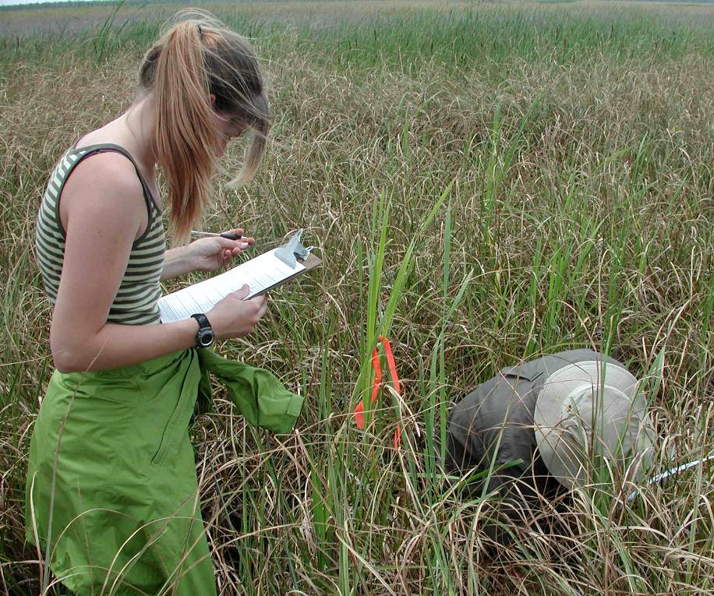
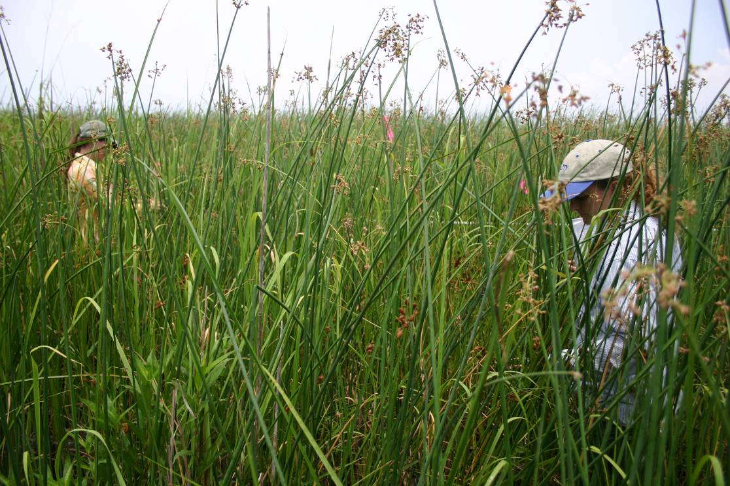
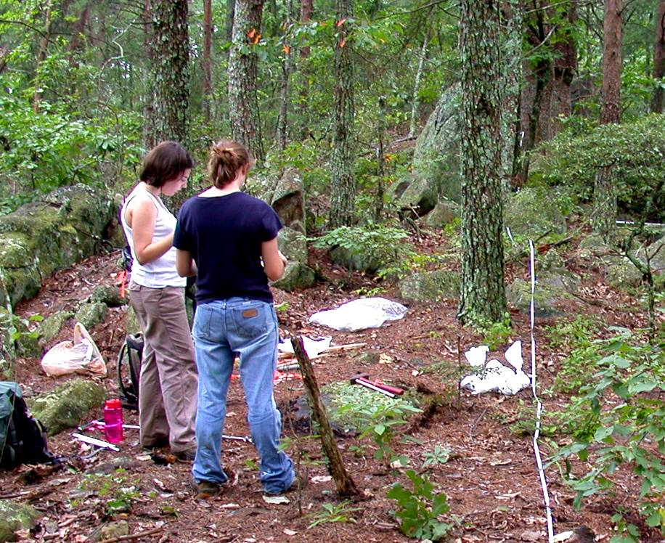
Standardized sampling approach to documenting vegetation and environmental attributes of reference sites
Extremely robust dataset from across NC and SC

Slide 5
North Carolina Ecosystem Enhancement Program
“The EEP mission is to restore, enhance, preserve and protect the functions associated with wetlands, streams, and riparian areas, including … restoration, maintenance and protection of water quality and riparian habitats …”

Slide 6
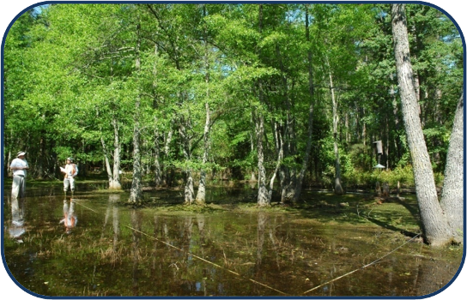
Collaboration Activities With NC
Ecosystem Enhancement Program ( began in 2005)
Restoration targets
Protocols
Data management
Data analysis
Training

Slide 7
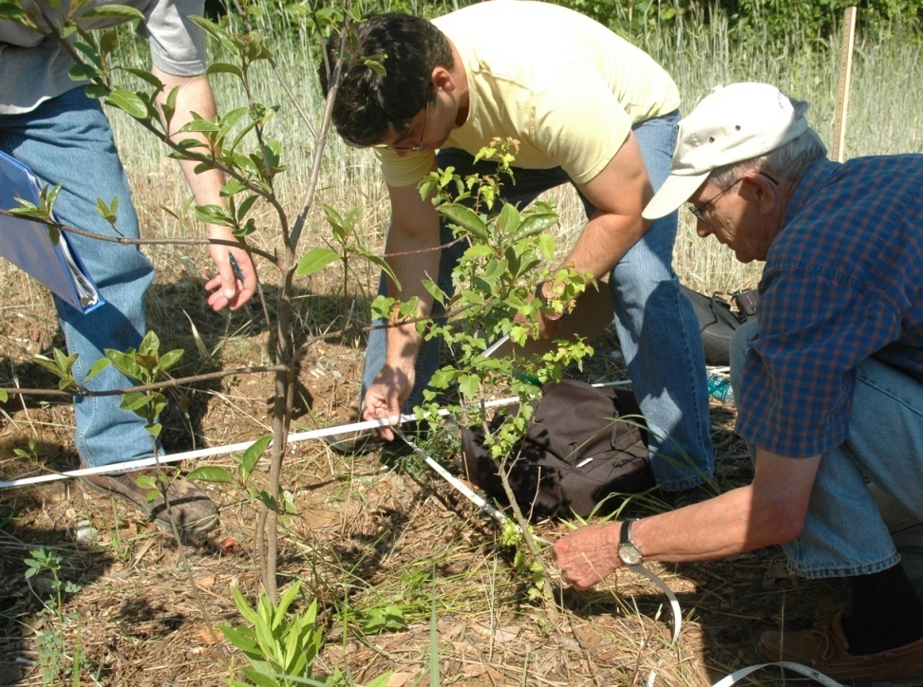
CVS Protocol and Tools for Restoration Monitoring
Sampling Protocol
Data Management
Data Analysis
Future Plans

Slide 8
Sampling Protocol – Fixed Area Plots
Consistent methodology
Appropriate for most vegetation types
FGDC compliant and broadly compatible
Flexible in intensity and time commitment
Easy to resample
Total floristics &/or tree population structure
Major site variables

Slide 9
Sampling Protocol – Scalable
Level 1: Inventory of planted stems
Level 2: Inventory of all woody stems
Level 3: Cover of dominants and
optional stem inventory
Level 4: Full floristics
Level 5: Full floristics, by module, across scales
RESTORATION PLOTS
OCCURRENCE PLOTS
REFERENCE PLOTS
COMPLEXITY

Slide 10
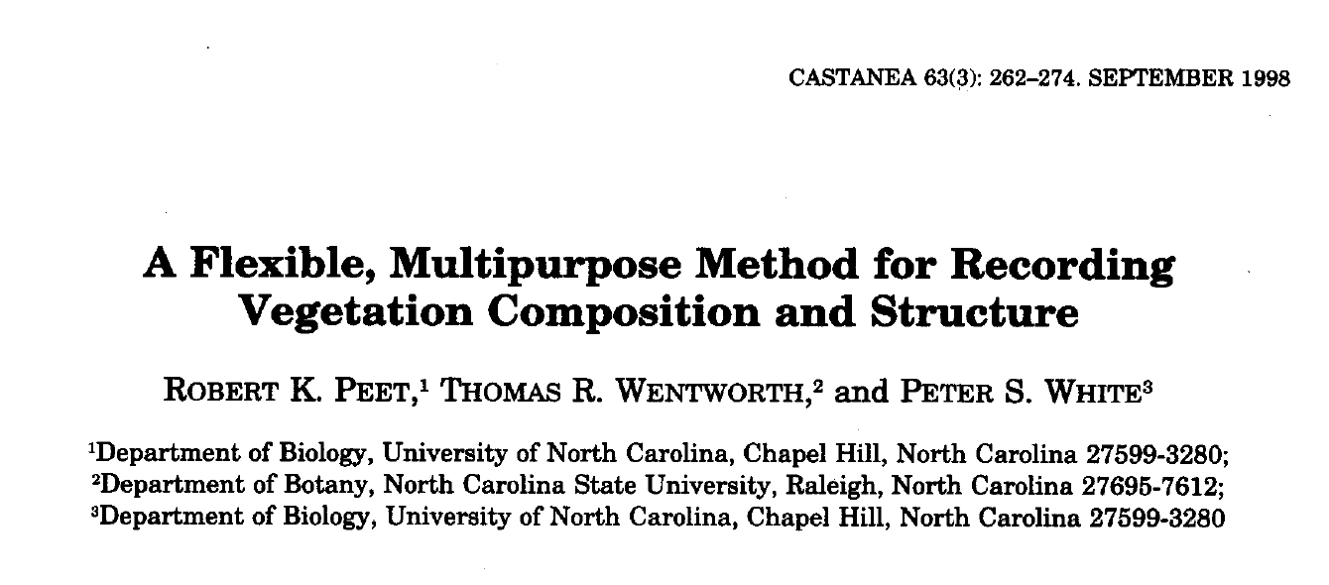
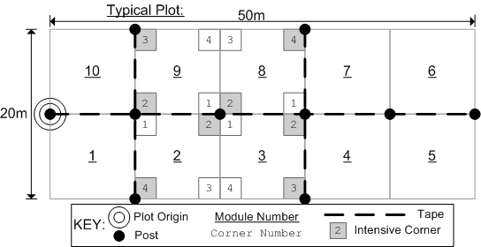
LEVEL 4 and 5 – The “Standard”

Slide 11
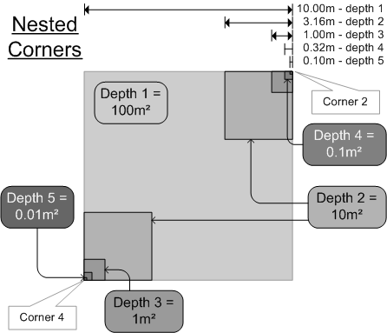
The Module = 1 are or 100 m²

Slide 12
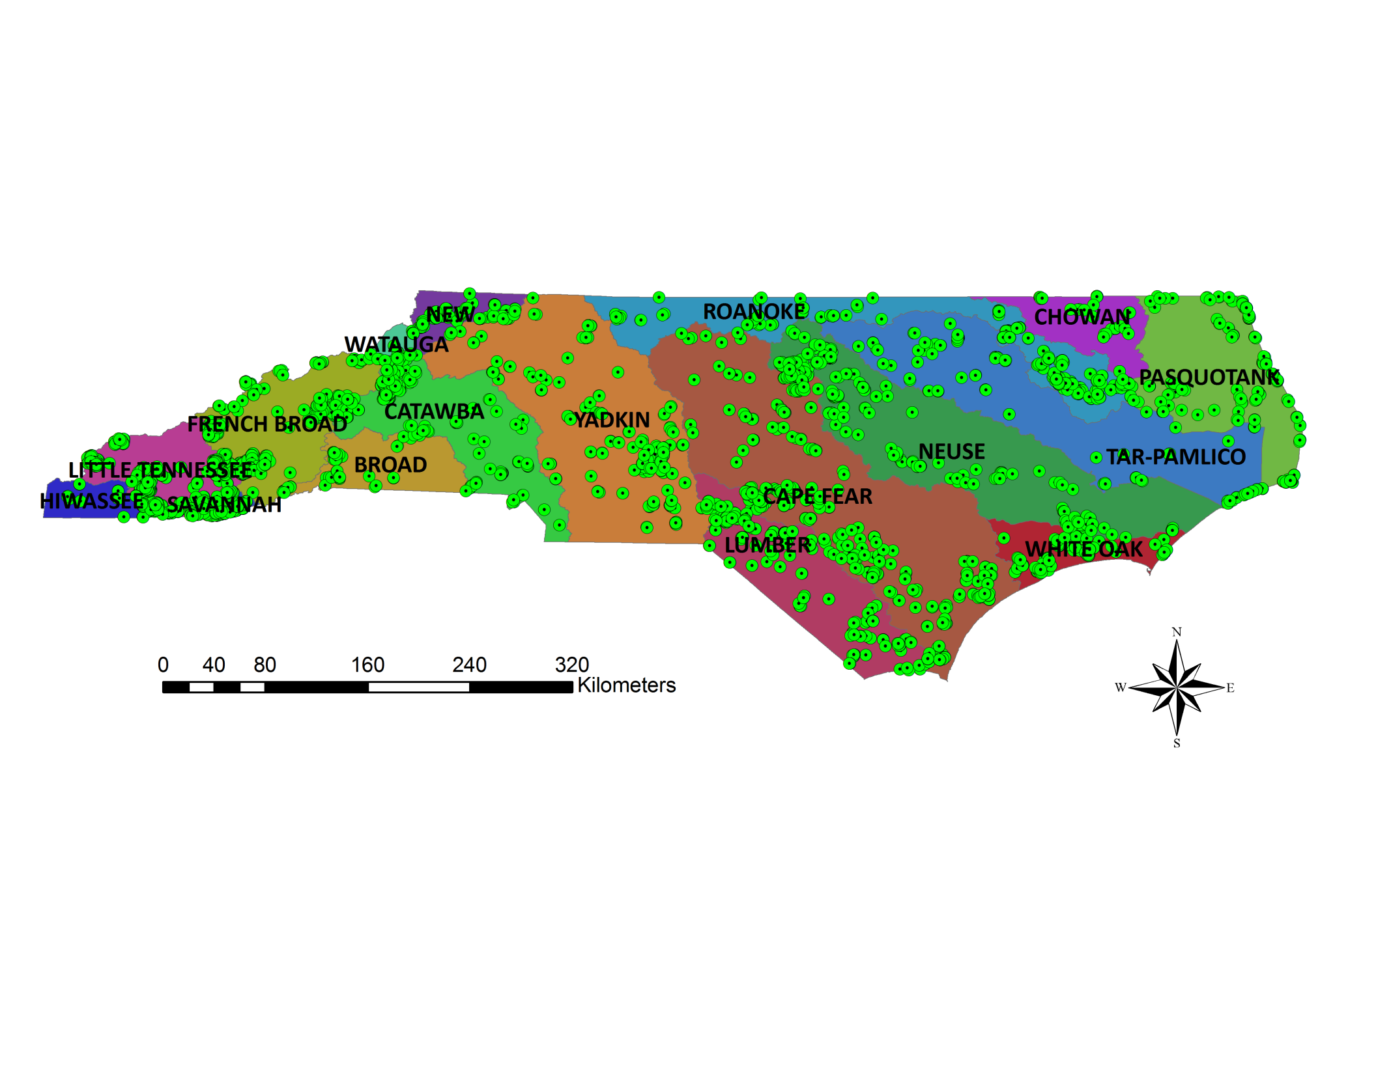
Distribution of CVS Level 4 and 5 Plots in NC (1988-2010)
5,223 plots in NC (+ 1,074 in SC)
2,782 species in NC
423 NVC Associations in NC
Plots conform to the FGDC standard
used to revise the NVC

Slide 13
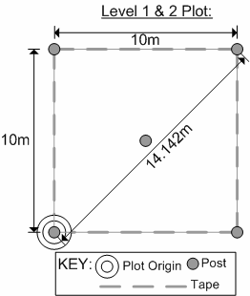
LEVEL 1 and 2 – Restoration Sites
LEVEL 1: Planted Stems
    - document installation and monitor survival and growth of installed plants
LEVEL 2: Planted Stems & Natural Stems
    - assessment of the overall status and trajectory of woody-plant restoration on a site

Slide 14
LEVEL 3– Community Occurrence
Documents leaf area cover of dominant species
Conforms to the FGDC standard for plots used to classify vegetation to an NVC association
Used to assess vegetation successional status as well as the presence and abundance of undesirable taxa

Slide 15
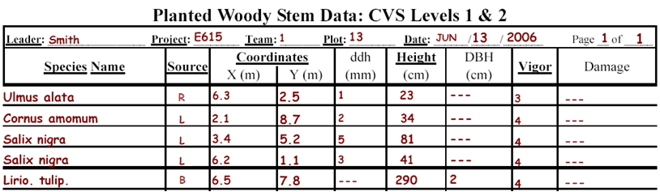
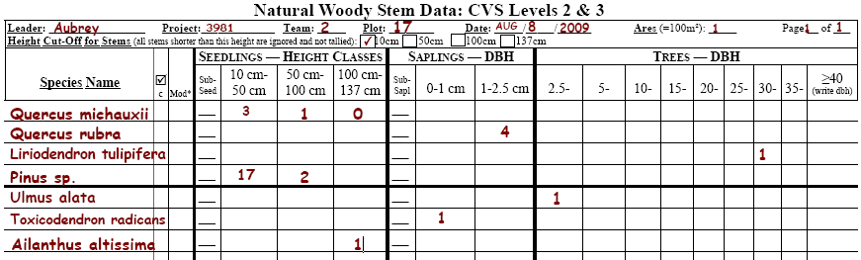
LEVEL 1 and 2 – Restoration Sites

Slide 16
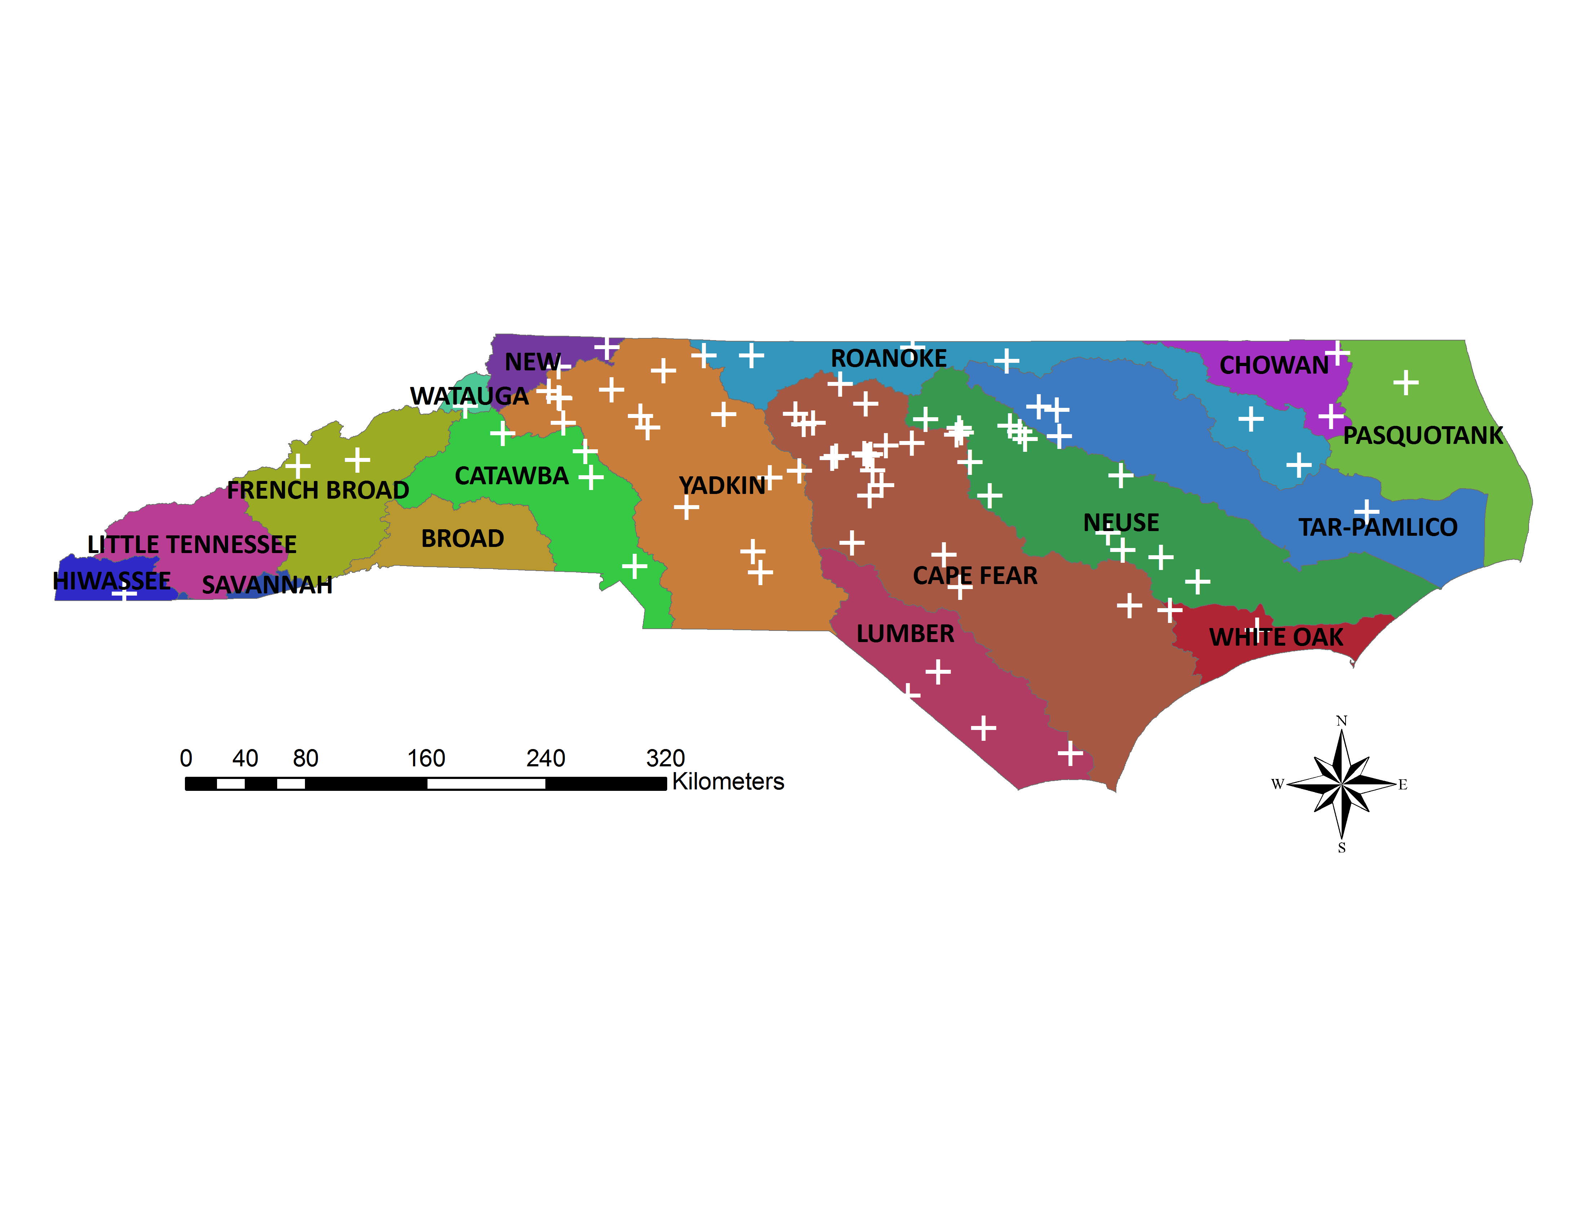
Distribution of EEP-CVS Restoration Projects in NC (2006-2010)
82 sites
30 design/monitoring firms
785 unique plots
30,544 planted woody stem individuals

Slide 17
CVS Data Management
Insures accurate data collection and reporting
Allows efficient data entry with automatic error checking
Reports and plot statistics can be automatically generated
Archived data are used in various analyses and to generate datasheets for subsequent monitoring

Slide 18
CVS Data Analysis
CVS reports
  Datasheets for monitoring
  Survival & growth of planted stems
  Direction of compositional change
  Rate of compositional change
  Problems needing attention
  (e.g., stem mortality, exotic species)
The data and services provided by CVS improve the likelihood that the monitored vegetation is developing towards a pre-defined reference condition.

Slide 19
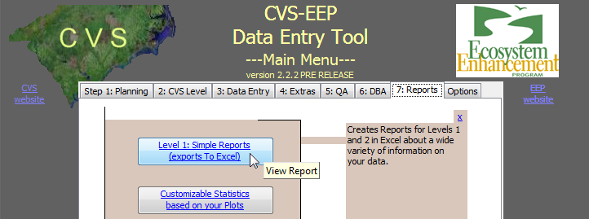
Report Generation Thru Entry Tool
Data summarized with click of a button
Multiple configuration options available
    Reports based on a single year or multiple years
    Reports based on a single project or multiple projects

Slide 20
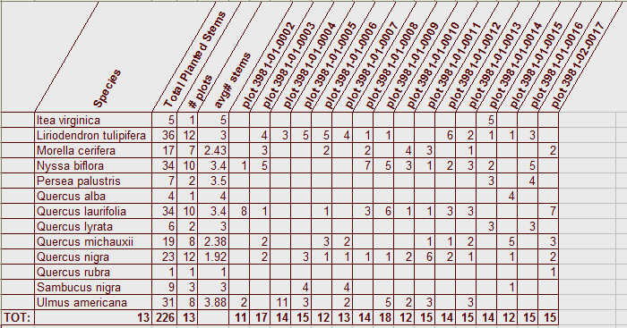
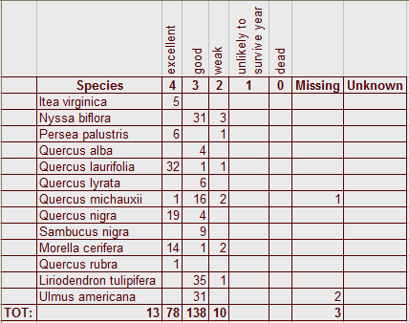
Summary Tables
Project Summary
Highlights year of project failing to meet requirements!
Matrix of plots, species, and number of stems
Summary of Stem Vigor

Slide 21
The Next Step…
Protocol Evaluation
  82 projects, 785 plots,+30,000 stems
  Explore usefulness of field measurements
    Wentworth “Use of survival data for planted woody stems to refine a vegetation monitoring protocol for restoration sites”
  Concurrent Session 4: Riparian Monitoring (10-11:30)
  Determine better ways to capture full project ‘success’
    “Sampling the Gaps”

Slide 22
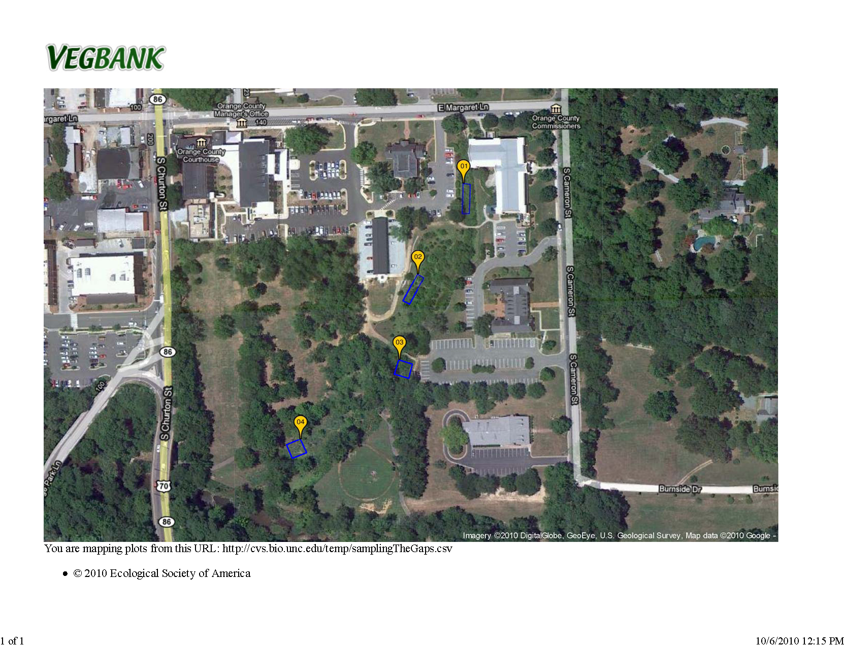
    “Sampling the Gaps”
    Stillhouse Creek, Orange County, NC
Stem data from plots indicate adequate stocking density…
…but may not reflect complete coverage across the entire project site

Slide 23
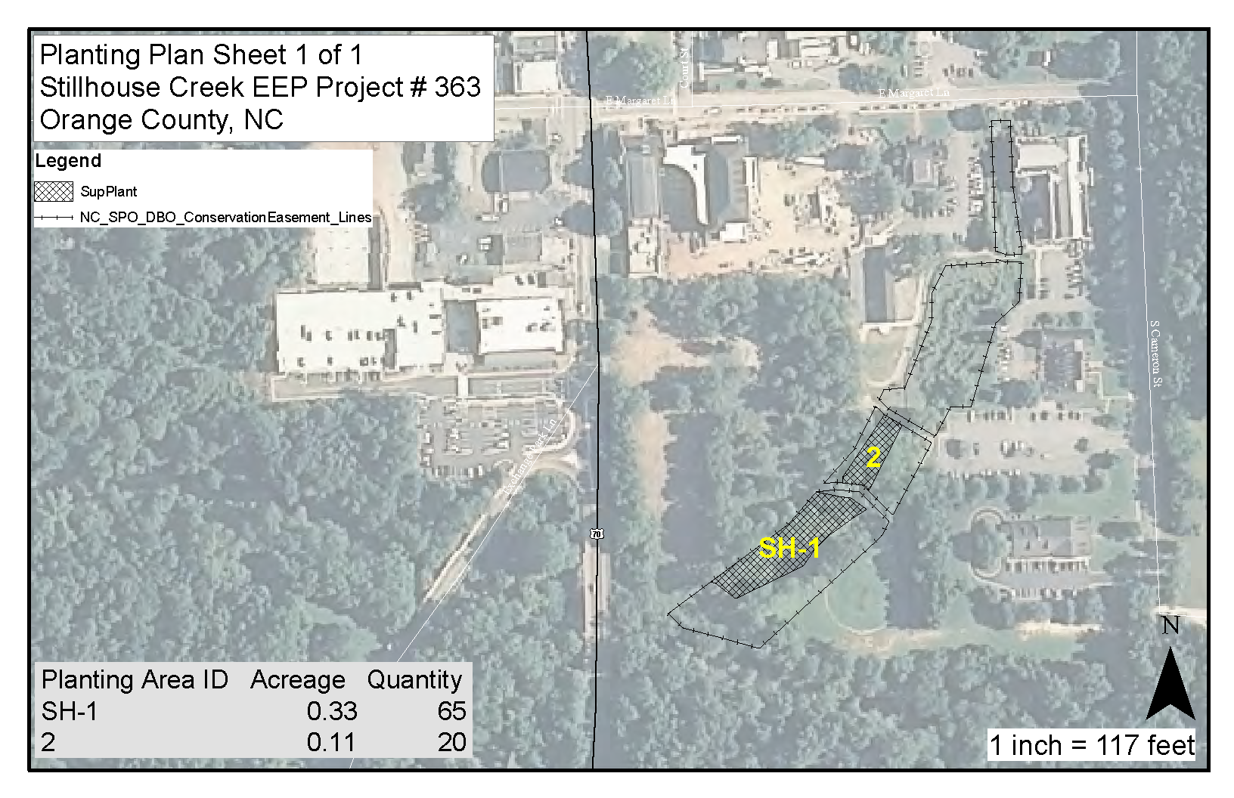

Slide 24
Solution: Strip Plot Approach
Designed to supplement
Level 1 and 2 CVS plots,
not replace
CVS plots allow for
early detection of
project failure AND
ability to document
relationship with natural
vegetation
ONE SCENARIO:
Year 0: baseline data (Level 1)
Year 1: monitoring data (Level 1)
Year 2: monitoring data (Level 1 and 2)
Year 3: strip plots
Year 4: monitoring data (Level 1 and 2)
Year 5: monitoring data (Level 1 and 2)

Slide 25
Solution: Strip Plot Approach
HIP CHAIN CAN BE USED TO
MEASURE DISTANCE ALONG
TRANSECT
RECORD ALL NATIVE (PLANTED
OR NATURAL) STEMS > 1 m HEIGHT
SUBDIVIDE TRANSECT INTO 10 m
SECTIONS
DON’T COUNT EVERYTHING!
  IF ZONE IS ADEQUATELY
  STOCKED (> 4 STEMS / 40 m2,
  ONLY RECORD ITS START/END
  POINT ALONG TRANSECT
NEED TO TEST THIS APPROACH ON LARGER EEP PROJECT SITES

Slide 26
The Next Step…
Bridging the Gap Between Restoration and Reference Sites
  Improve planted species lists
  Sharpen the focus of localized communities
  Ensure web-based approach
  Peet “Application of Carolina Vegetation Survey inventory data for generation and evaluation of restoration targets”
  Matthews “An expert system for generating restoration targets for Carolina Piedmont riparian vegetation”
  Concurrent Session 6: Riparian Restoration Tools (3-4:30)

Slide 27
Summary of Benefits
Protocols and tools greatly improve
efficiency:
      ease of resample
      individual stems
      data management scheme minimizes errors and anticipates problems
      data analysis keeps EEP informed of trajectory of each project

Slide 28
Summary of Benefits
Consistency of methodology increases
likelihood of project success (two-fold):
      close-out requirements (USACE and NC DWQ)
      natural vegetation of North Carolina

Slide 29
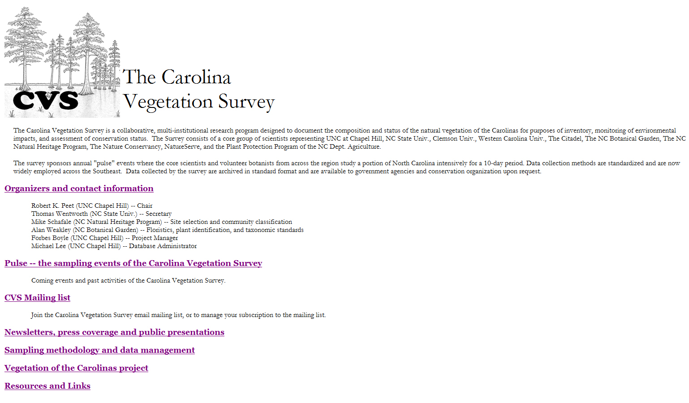
http://cvs.bio.unc.edu/
Thank You!

